Slide 1
Shortest Path Definitions

Slide 2
Shortest Path Problems
How can we find the shortest route between two points on a road map?
Model the problem as a graph problem:
Road map is a weighted graph:
vertices = cities
edges = road segments between cities
edge weights = road distances
Goal: find a shortest path between two vertices (cities)

Slide 3
Shortest Path Problem
Input:
Directed graph G = (V, E)
Weight function w : E → R
Weight of path p = ⟨v₀, v₁, . . . , v_{k}⟩
Shortest-path weight from u to v:
δ(u, v) = min w(p) : u v if there exists a path from u to v
∞ otherwise
Note: there might be multiple shortest paths from u to v
t
x
3
6
9
3
2
1
4
s
0
2
7
5
3
5
6
11
y
z
p

Slide 4
Variants of Shortest Path
Single-source shortest paths
G = (V, E) ⇒ find a shortest path from a given source vertex s to each vertex v ∈ V
Single-destination shortest paths
Find a shortest path to a given destination vertex t from each vertex v
Reversing the direction of each edge ⇒ single-source

Slide 5
Variants of Shortest Paths (cont’d)
Single-pair shortest path
Find a shortest path from u to v for given vertices u and v
All-pairs shortest-paths
Find a shortest path from u to v for every pair of vertices u and v

Slide 6
Negative-Weight Edges
Negative-weight edges may form negative-weight cycles
If such cycles are reachable from
the source, then δ(s, v) is not properly
defined!
Keep going around the cycle, and get
w(s, v) = - ∞ for all v on the cycle
a
b
-4
3
c
4
6
d
g
s
0
5
8
y
-3
2
3
7
e
-6
f

Slide 7
Negative-Weight Edges
s → a: only one path
δ(s, a) = w(s, a) = 3
s → b: only one path
δ(s, b) = w(s, a) + w(a, b) = -1
s → c: infinitely many paths
⟨s, c⟩, ⟨s, c, d, c⟩, ⟨s, c, d, c, d, c⟩
cycle has positive weight (6 - 3 = 3)
⟨s, c⟩ is shortest path with weight δ(s, b) = w(s, c) = 5
a
b
3
-4
-1
3
c
4
6
d
g
s
0
5
5
11
8
-∞
y
-3
2
3
7
-∞
-∞
e
-6
f

Slide 8
Negative-Weight Edges
s → e: infinitely many paths:
⟨s, e⟩, ⟨s, e, f, e⟩, ⟨s, e, f, e, f, e⟩
cycle ⟨e, f, e⟩ has negative weight:
3 + (- 6) = -3
can find paths from s to e with arbitrarily large negative weights
δ(s, e) = - ∞ ⇒ no shortest path exists between s and e
Similarly: δ(s, f) = - ∞, δ(s, g) = - ∞
a
b
3
-4
-1
3
c
4
6
d
g
s
0
5
5
11
8
-∞
y
-3
2
3
7
-∞
-∞
e
-6
f
h
i
∞
2
∞
h, i, j not
reachable
from s
-8
3
∞
j
δ(s, h) = δ(s, i) = δ(s, j) = ∞

Slide 9
Cycles
Can shortest paths contain cycles?
Negative-weight cycles
Shortest path is not well defined
Positive-weight cycles:
By removing the cycle, we can get a shorter path
Zero-weight cycles
No reason to use them
Can remove them to obtain a path with same weight
No!
No!

Slide 10
Algorithms
Bellman-Ford algorithm
Negative weights are allowed
Negative cycles reachable from the source are not allowed.
Dijkstra’s algorithm
Negative weights are not allowed
Operations common in both algorithms
Initialization
Relaxation

Slide 11
Shortest-Paths Notation
For each vertex v ∈ V:
δ(s, v): shortest-path weight
d[v]: shortest-path weight estimate
Initially, d[v]=∞
d[v]→δ(s,v) as algorithm progresses
π[v] = predecessor of v on a shortest path from s
If no predecessor, π[v] = NIL
π induces a tree—shortest-path tree
t
x
3
6
9
3
2
1
4
s
0
2
7
5
3
5
6
11
y
z

Slide 12
Dijkstra's algorithm

Slide 13
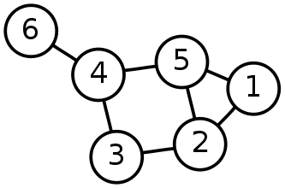
Single-Source Shortest Path Problem
Single-Source Shortest Path Problem - The problem of finding shortest paths from a source vertex v to all other vertices in the graph.

Slide 14
Dijkstra's algorithm
Dijkstra's algorithm - is a solution to the single-source shortest path problem in graph theory.
Works on both directed and undirected graphs. However, all edges must have nonnegative weights.
Approach: Greedy
Input: Weighted graph G={E,V} and source vertex v∈V, such that all edge weights are nonnegative
Output: Lengths of shortest paths (or the shortest paths themselves) from a given source vertex v∈V to all other vertices

Slide 15
Dijkstra's algorithm - Pseudocode
dist[s] ←0 (distance to source vertex is zero) for all v ∈ V–{s} do dist[v] ←∞ (set all other distances to infinity) S←∅ (S, the set of visited vertices is initially empty) Q←V (Q, the queue initially contains all vertices) while Q ≠∅ (while the queue is not empty) do u ← mindistance(Q,dist) (select the element of Q with the min. distance) S←S∪{u} (add u to list of visited vertices) for all v ∈ neighbors[u] do if dist[v] > dist[u] + w(u, v) (if new shortest path found) then d[v] ←d[u] + w(u, v) (set new value of shortest path)
(if desired, add traceback code)
return dist

Slide 16
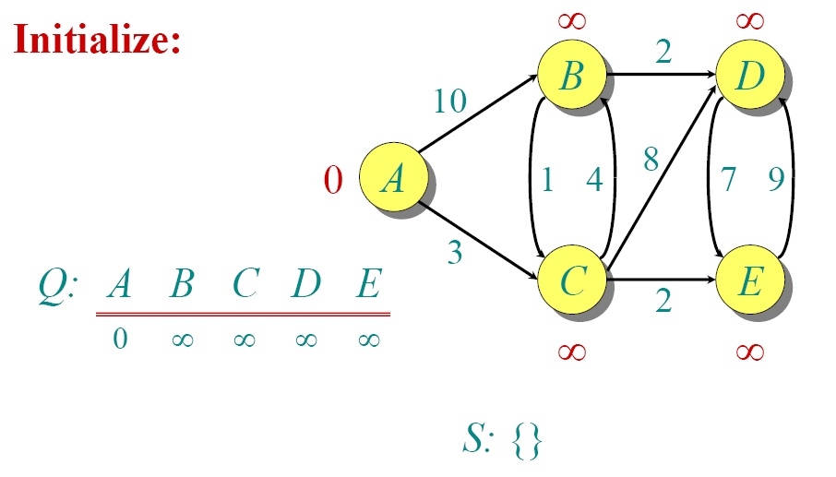
Dijkstra Animated Example

Slide 17
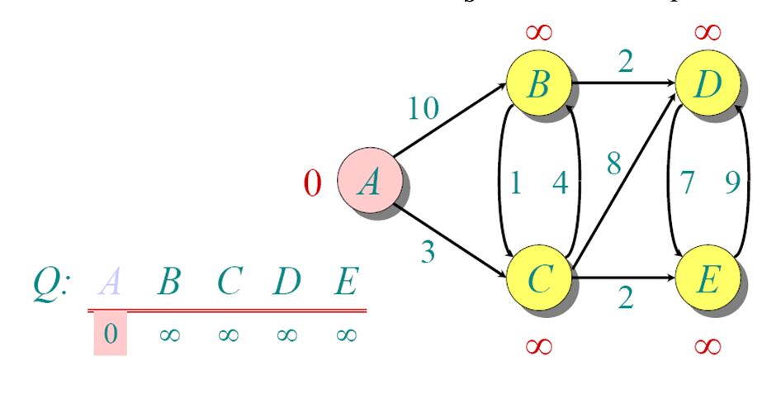
Dijkstra Animated Example

Slide 18
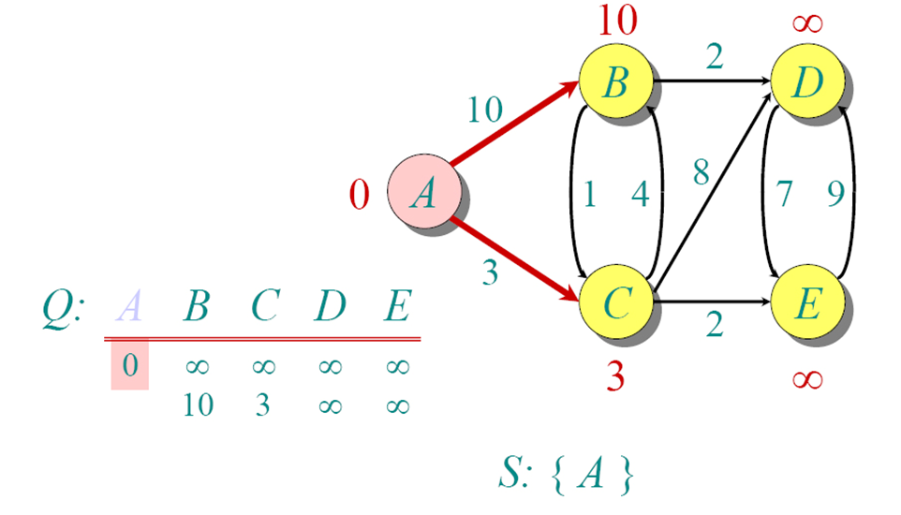
Dijkstra Animated Example

Slide 19
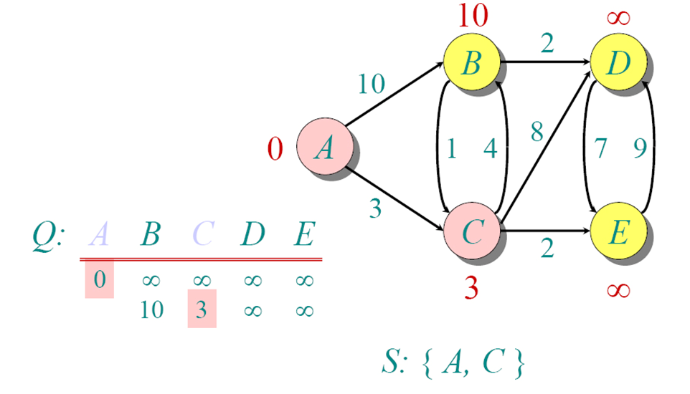
Dijkstra Animated Example

Slide 20
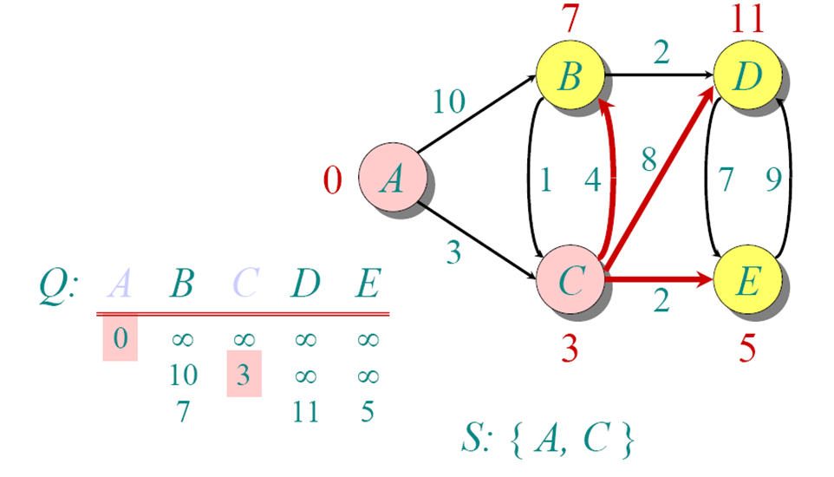
Dijkstra Animated Example

Slide 21
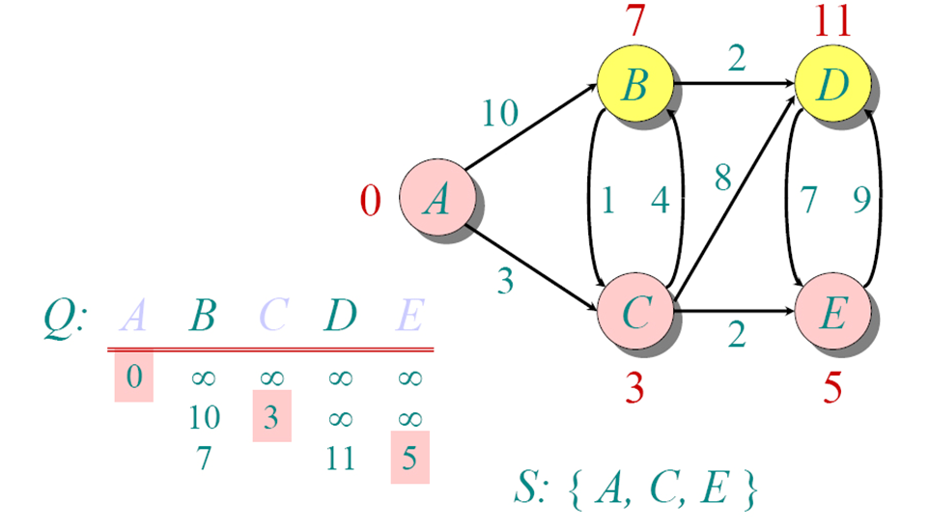
Dijkstra Animated Example

Slide 22
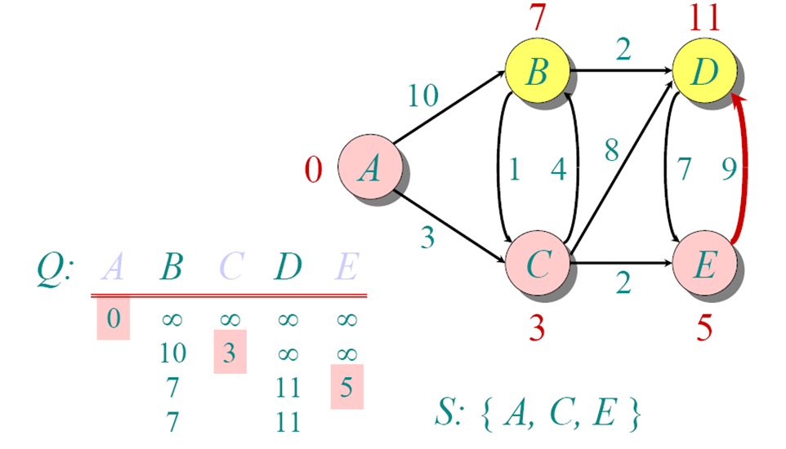
Dijkstra Animated Example

Slide 23
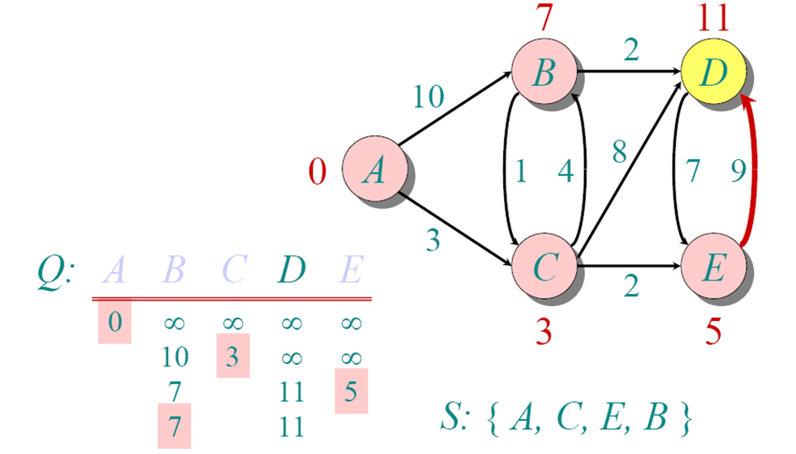
Dijkstra Animated Example

Slide 24
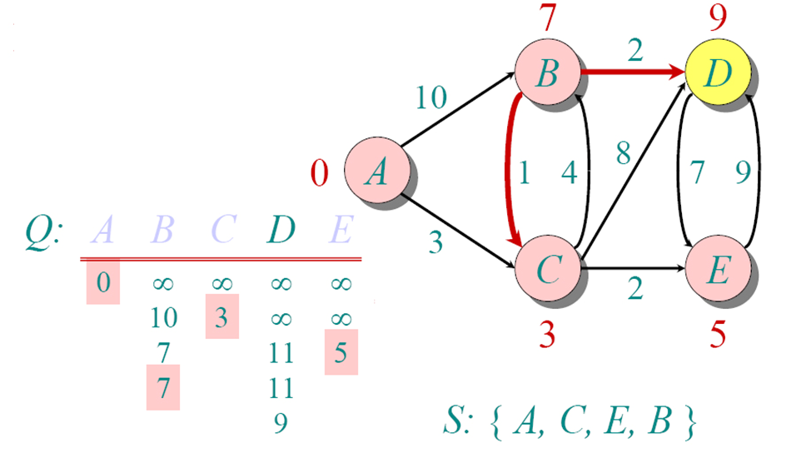
Dijkstra Animated Example

Slide 25
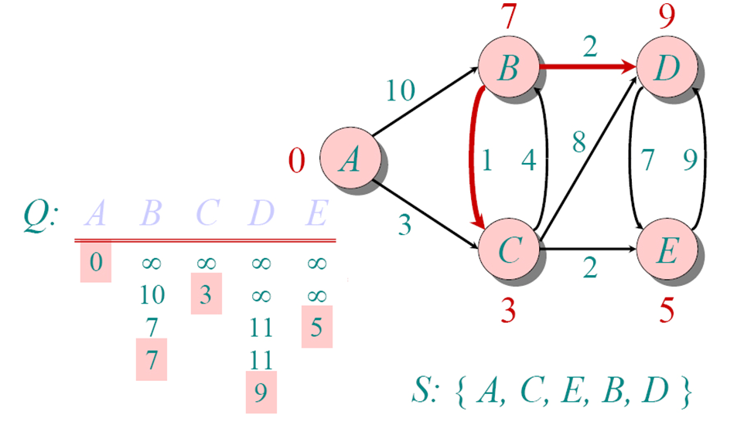
Dijkstra Animated Example

Slide 26
Implementations and Running Times
The simplest implementation is to store vertices in an array or linked list. This will produce a running time of
O(|V|^2 + |E|)
For sparse graphs, or graphs with very few edges and many nodes, it can be implemented more efficiently storing the graph in an adjacency list using a binary heap or priority queue. This will produce a running time of
O((|E|+|V|) log |V|)

Slide 27
Dijkstra's Algorithm - Why It Works
As with all greedy algorithms, we need to make sure that it is a correct algorithm (e.g., it always returns the right solution if it is given correct input).
A formal proof would take longer than this presentation, but we can understand how the argument works intuitively.
If you can’t sleep unless you see a proof, see the second reference or ask us where you can find it.

Slide 28
Dijkstra's Algorithm - Why It Works
To understand how it works, we’ll go over the previous example again. However, we need two mathematical results first:
Lemma 1: Triangle inequality If δ(u,v) is the shortest path length between u and v, δ(u,v) ≤ δ(u,x) + δ(x,v)
Lemma 2: The subpath of any shortest path is itself a shortest path.
The key is to understand why we can claim that anytime we put a new vertex in S, we can say that we already know the shortest path to it.

Slide 29
Dijkstra's Algorithm - Why use it?
As mentioned, Dijkstra’s algorithm calculates the shortest path to every vertex.
However, it is about as computationally expensive to calculate the shortest path from vertex u to every vertex using Dijkstra’s as it is to calculate the shortest path to some particular vertex v.
Therefore, anytime we want to know the optimal path to some other vertex from a determined origin, we can use Dijkstra’s algorithm.

Slide 30
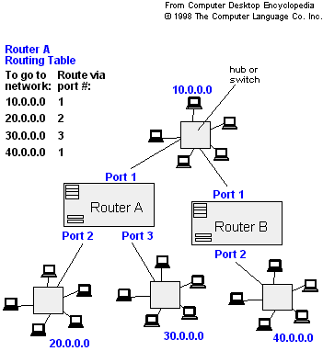
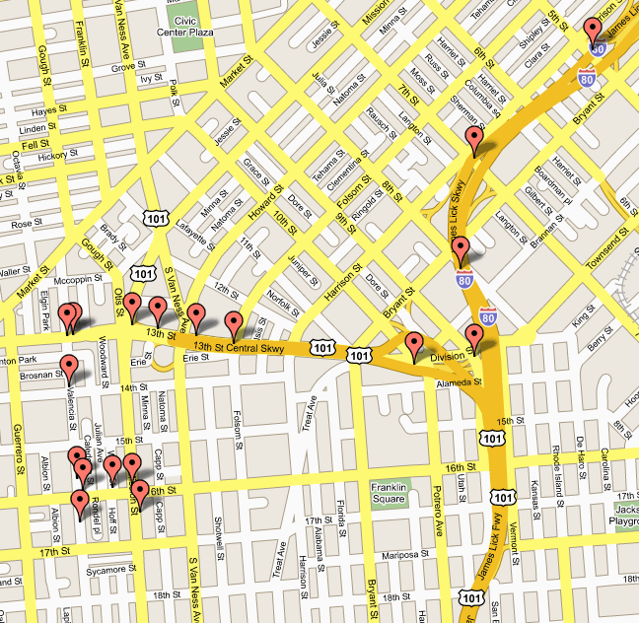
Applications of Dijkstra's Algorithm
- Traffic Information Systems are most prominent use
- Mapping (Map Quest, Google Maps)
- Routing Systems

Slide 31
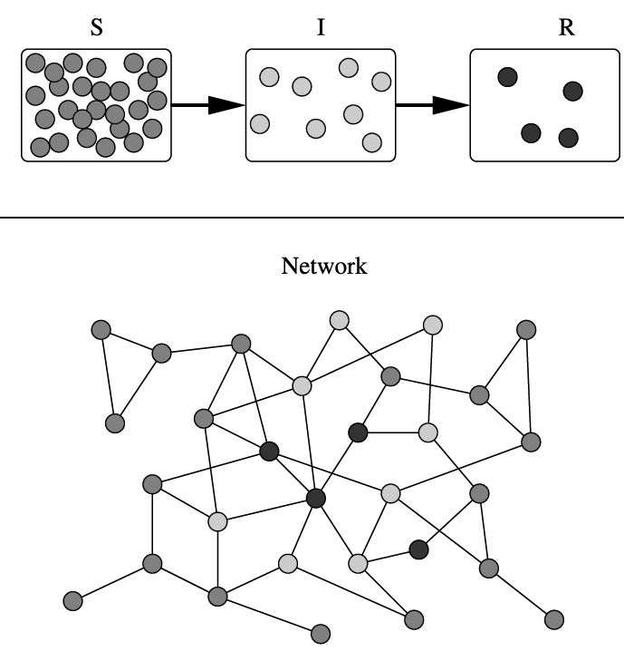
Applications of Dijkstra's Algorithm
One particularly relevant this week: epidemiology
Prof. Lauren Meyers (Biology Dept.) uses networks to model the spread of infectious diseases and design prevention and response strategies.
Vertices represent individuals, and edges their possible contacts. It is useful to calculate how a particular individual is connected to others.
Knowing the shortest path lengths to other individuals can be a relevant indicator of the potential of a particular individual to infect others.

Slide 32
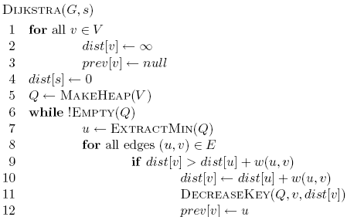
Heap
B 2 E 5 D ∞
2
∞
3
B
D
3
0
1
A
1
2
Frontier?
1
1
C
E
5
4

Slide 33
Heap
B 2 E 5 D ∞
2
∞
3
B
D
3
0
All nodes reachable from starting node within a given distance
1
A
1
2
1
1
C
E
5
4

Slide 34
Heap
E 3 D 5
2
5
3
B
D
3
0
1
A
1
2
1
1
C
E
3
4

Slide 35
Heap
D 5
2
5
3
B
D
3
0
1
A
1
2
1
1
C
E
3
4

Slide 36
Heap
2
5
3
B
D
3
0
1
A
1
2
1
1
C
E
3
4

Slide 37
Heap
2
5
3
B
D
0
1
A
1
1
1
C
E
3

Slide 38
What about Dijkstra’s on…?
1
1
B
D
A
5
10
-10
C
E

Slide 39
What about Dijkstra’s on…?
1
1
B
D
A
5
10
-10
C
E

Slide 40
What about Dijkstra’s on…?
Dijkstra’s algorithm only works for positive edge weights
1
1
B
D
A
5
10
C
E

Slide 41
Dijkstra’s Algorithm For Shortest Paths
Non-negative edge weight
Like BFS: If all edge weights are equal, then use BFS, otherwise use this algorithm
Use Q = min-priority queue keyed on d[v] values

Slide 42
Dijkstra’s Algorithm For Shortest Paths
DIJKSTRA(G, s)
INIT(G, s)
S←Ø > set of discovered nodes
Q←V[G]
while Q ≠Ø do
u←EXTRACT-MIN(Q)
S←S U {u}
for each v in Adj[u] do
RELAX(u, v) > May cause
> DECREASE-KEY(Q, v, d[v])

Slide 43
Example: Initialization Step

Slide 44
Example
u
v
∞
1
∞
10
0
2
3
9
s
4
6
7
5
∞
∞
2
x
y

Slide 45
Example
u
v
10
1
∞
10
9
0
3
2
s
4
6
7
5
5
∞
2
x
y

Slide 46
Example
u
v
8
1
14
10
0
3
9
2
s
4
6
7
5
5
7
2
x
y

Slide 47
Example
u
v
8
1
13
10
2
3
9
s
0
4
6
7
5
5
7
2
x
y

Slide 48
Example
u
v
8
1
9
10
0
2
3
9
s
4
6
7
5
5
7
2
x
y

Slide 49
Example
u
v
8
1
9
10
2
3
9
0
4
6
s
7
5
5
7
2
x
y

Slide 50
Dijkstra’s Algorithm Analysis
O(V)
O(V Log V)
Total in the loop: O(V Log V)
Total in the loop: O(E Log V)
Time Complexity: O (E Log V)

Slide 51
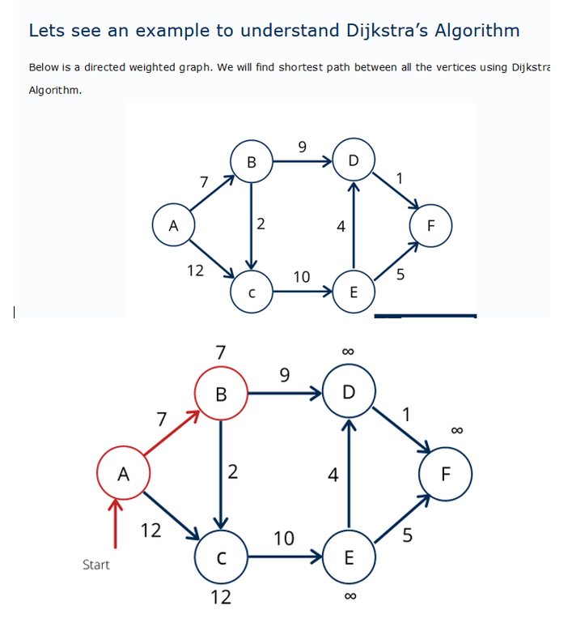
Example – Dijkstra’s Algorithm

Slide 52
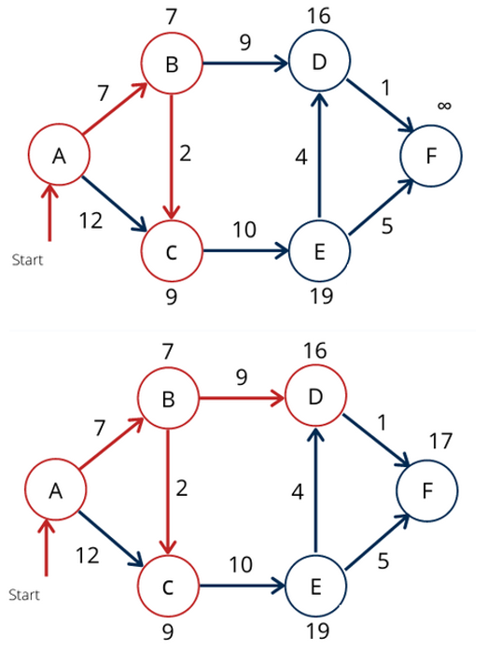
Example – Dijkstra’s Algorithm-Cont’d

Slide 53
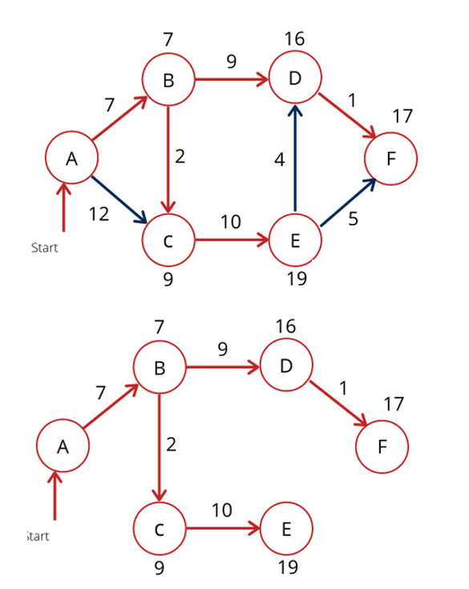
Example – Dijkstra’s Algorithm-Cont’d

Slide 54
References
Dijkstra’s original paper: E. W. Dijkstra. (1959) A Note on Two Problems in Connection with Graphs. Numerische Mathematik, 1. 269-271.
MIT OpenCourseware, 6.046J Introduction to Algorithms. < http://ocw.mit.edu/OcwWeb/Electrical-Engineering-and-Computer-Science/6-046JFall-2005/CourseHome/> Accessed 4/25/09
Meyers, L.A. (2007) Contact network epidemiology: Bond percolation applied to infectious disease prediction and control. Bulletin of the American Mathematical Society 44: 63-86.
Department of Mathematics, University of Melbourne. Dijkstra’s Algorithm. <http://www.ms.unimelb.edu.au/~moshe/620-261/dijkstra/dijkstra.html > Accessed 4/25/09

